Slide 1
SEARCH ENGINES
Search engines are programs that search documents for specified keywords and returns a list of the documents where the keywords were found.

Slide 2
Search Engines are Determined by two main requirements
Effectiveness (quality of results)
As good as possible
Efficiency (response time and throughput)
As quickly as possible

Slide 3
Web Search Engines
Web search engines work by sending out a spider to fetch as many documents as possible. Another program, called an indexer, then reads these documents and creates an index based on the words contained in each document. Each search engine uses a proprietary algorithm to create its indices such that, ideally, only meaningful results are returned for each query.
Spider
A program that automatically fetches Web pages. Spiders are used to feed pages to search engines. It's called a spider because it crawls over the Web. Another term for these programs is webcrawler.
Website owners have to optimize their web content to improve the placement of that content in search engine results. The process is called Search Engine Optimization(SEO)
Prominent web search Engines
Google search
Duck Duck Go search
Bing Search
Dogpile Search
Yippy Search
Yahoo Search
The Internet Archive Search
Baidu search

Slide 4
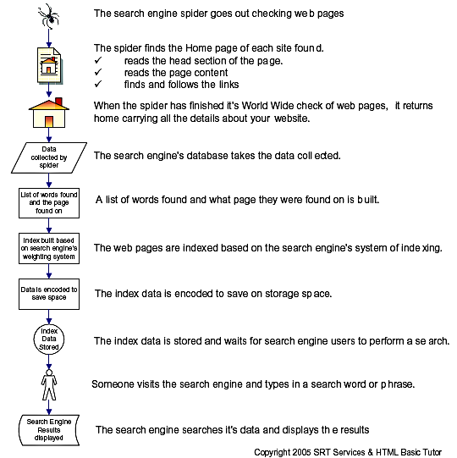

Slide 5
HOW A SERCH ENGINE WORKS

Slide 6
Crawling is the process where the search engine goes around from website to website, finding new and updated information to report back to the search engine. using links.
Indexing is the processing of the information gathered by the crawler/spider/robot from its crawling
activities. Once documents are processed, they are added to search engine’s searchable index if they are determined to be quality content. During indexing, the search engine processes the words on a page and where those words are located. Information such as title tags and ALT attributes
are also analyzed during indexing.

Slide 7
Types of Search Engines
Crawler based
They crawl or spider the web and then people search through what they have found. They create their listings automatically such as google.
Meta search Engine
A search engine that queries other search engines and then combines the results that are received from all.
Human-powered directories
Depends on humans for its listings. You submit a short description to directory for your entire site. A search looks for matches only in the descriptions submitted.
Hybrid Search Engines
Presents both crawler based and human powered listing and it favors one listing over the other.

Slide 8
Search strategies
Keyword searching
Enter terms to search, use quotation marks to search as a phrase and keep the words linked together.
Common words are ignored(that, to, which, a, the…)
+ and – can be used to include or exclude a word
e.g. “Yoweri ” + president
A + symbol preceding a word requires that a word is present in the document.
A – symbol preceding a keyword ensures that the word is not present in the returned document.
Note that all words that must contain in the document should be preceded by a + symbol, even the first word. E.g. +fraud +elections ensures that fraud is also in all the documents.
Boolean Searching
1.Boolean Searching-AND
Enter words connect with AND - it will include sites where both words are found
Uses: joining different topics
(i.e. “global warming” AND California)

Slide 9
2.Boolean Searching- OR
Enter words connect with OR - requires at least one of the terms is found
Uses: join similar or synonymous topics
(i.e. “global warming” OR “greenhouse effect”)
3.Boolean Searching – NOT
Enter words connect with NOT – searches for the first term and excludes sites that have the second term
Uses: join similar or synonymous topics (i.e. Washington NOT school)
4.Boolean Searching – Nesting (Near)
In a string of searching, terms placed in parentheses are searched first
Parentheses must be used to group items if there is another Boolean operator being used
NEAR may be used to require words to be found within 16 words of each other in the pages returned
In many length documents, just using the AND operator might not provide useful results as the two keywords may be located in very different parts of the document and might not be related to one another.
e.g.(“global warming” NEAR “sea level rise”) AND “pacific coast”

Slide 10
Question Searching
A question may be entered in the search field of a search engine.
Ask Jeeves is a search engine that encourages the use of question searching
e.g Why is the sky blue?
Advanced searching
Advanced search features are offered on many engines by going to an “Advanced Search” page and making selections
This is effective in narrowing search returns to a specific topic or phrase
Google Advanced Search

Slide 11
Truncation.
If you are looking for information on for example gardening, you could use it as a keyword. However if your results are limited in number and you want to broaden your search, use a root part of the word and abbreviate it with an asterisk.
E.g. garden*. Here the engine will return links to documents containing gardens, gardener , gardeners, gardening, and so on.
Quick searches.
Many search engines now allow you to quickly search for specific types of content. Simply by including a keyword at the beginning of your search. For example if you need to find out the weather forecast in Kampala, simply type “weather Kampala” and you should get the current forecast for Kampala.
Also if you need a definition , include the word “dictionary” before the word.
Quick searches work for many types of information, and don’t always require keywords . for example;
If you want to figure out how many dollars in 5 pounds, type “dollars in 5 pounds”
If you enter a mathematical equation, the search engine will return the answer.
Entering the tracking code for a package will bring up the shipping details

